Slide 1



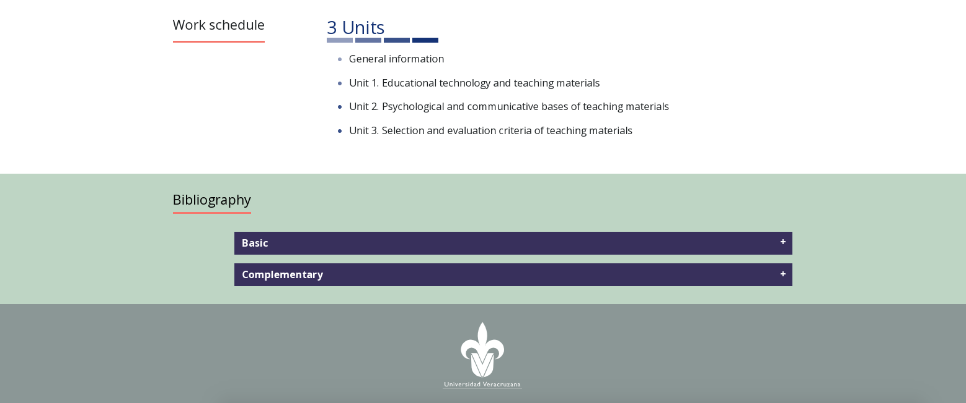
DG/P:
Verificar colores de acuerdo a criterios de accesibilidad.
Imagen acorde al nuevo nombre de la EE.
Menú lateral izquierdo.
Home
General information
Unit 1: Grammar and Use of English
Unit 2: Reading and Writing
Unit 3: Speaking and Listening
Unit 4. Getting to know additional C1 exams
Final Exam
Bibliografía se añade conforme se construya el curso.
Síntesis curricular en siguiente diapositiva.
La fotografía ya estaba en el curso anterior.
Menu
HTML Outliner:
English Proficiency
Student’s level of competence
Description
Course designer
Work schedule
General information
Unit 1. Grammar and Use of English
Unit 2. Reading and Writing
Unit 3. Speaking and Listening
Unit 4. Getting to know additional C1 exams
Final Exam
Bibliography
Imagen
English Proficiency
Área de formación
Formación disciplinar
Pre-requisitos
Certificado de lengua B2
Créditos
12
Level of students’ competence
Students will use oral and written English, incorporating complex syntactic and lexical structures in social, academic and professional contexts, through self-reflective and collaborative linguistic practices, performing with honesty, responsibility and commitment, with the aim of developing a proficiency level that corresponds to the C1 level of English, according to the CEFRL.
Description
The course is composed of four units. Unit One begins with an overview of the notions of Communicative Competence and Language Proficiency, and the relationship between them and the Common European Framework of Reference for Languages. In this first Unit, learners will be able to reflect on their own shortcomings, in order to facilitate autonomous learning. Unit one also introduces practice for C1 examination tasks, such as those from the Certificate of Advanced English (CAE), beginning with Grammar and Use of English. Unit two concentrates of Reading and Writing. Unit three on Speaking and Listening. Unit four provides an overview of tasks included in two similar C1 certification exams: IELTS and TOEFL iBT.
Throughout the course, students will be working both autonomously and in groups. Evaluation and feedback will be a continuous process in order to prepare learners for the Final Exam, based on the CAE.
Course designer
Foto
M.A. Reyna Isidra López Ble
Work schedule
4 Units
General information
Unit 1. Grammar and Use of English
Unit 2. Reading and Writing
Unit 3. Speaking and Listening
Unit 4. Getting to know additional C1 exams
Final Exam
Bibliography

Slide 2
Course designer
Reyna Isidra López Blé studied the BA in English and the BA in French at the University of Veracruz. She graduated with Distinction from the MA in Teaching English as a Foreign Language and she also obtained the MA in French Didactics at the same university. She has been a teacher of English and French in Higher Education for more than 12 years. At the moment, she teaches a variety of courses at the BA in English, the BA in French and the Online BA in ELT at Universidad Veracruzana. She holds a C2 level English certification by the University of Cambridge and a C2 level French Certification.
She is an EXAVER (1, 2, and 3) examiner. She participated in the certification process of the BA in ELT and she is part of the redesign committee of the same programme. She has supervised a number of undergraduate and graduate research papers and collaborates with the Research Group Lingüística Aplicada a la Enseñanza y Aprendizaje del Inglés (CA UV 543). She has participated as a presenter and attendee in numerous national conferences and has published book chapters and journal articles. She is interested in research on EFL Academic Writing, Academic Writing and Identity, Systemic Functional Linguistics and Language Teaching and Learning processes, amongst others.
Fuentes de información
Añadir las fuentes conforme se vaya creando el curso

Slide 3
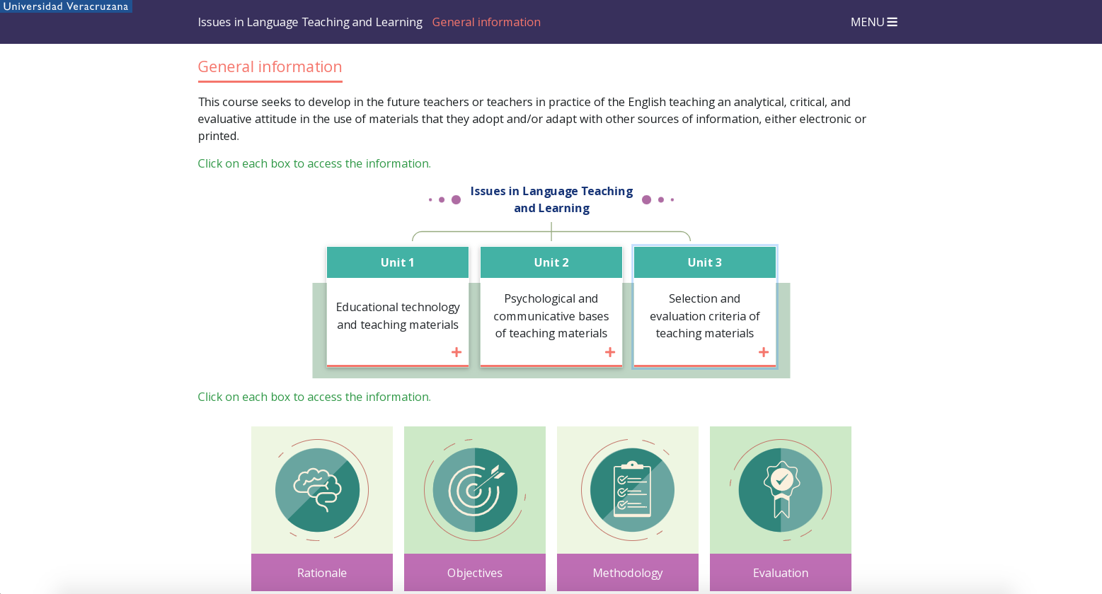
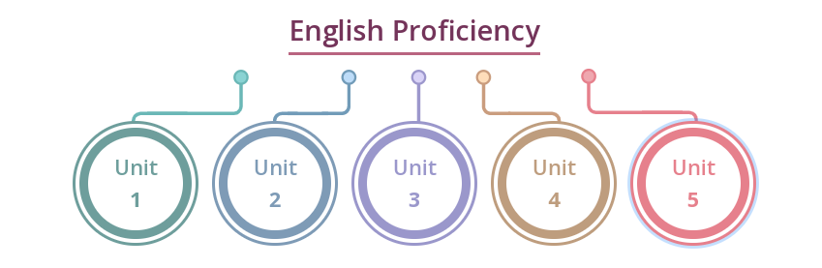
DG/P:
Verificar colores de acuerdo a criterios de accesibilidad.
Escritorio
Diseñar un esquema para las 4 unidades. El esquema funciona como modales.
Recurso de faqs.
Información para ambos recursos en siguiente diapositiva.
Dispositivos
Pasar a texto plano la información de las modales.
El recurso de faqs poner en texto plano todo, excepto las tablas de evaluation. Las tablas irían en PDF.
Material Design and Evaluation
General information
English Proficiency
HTML Outline:
General information
Objectives
Rationale
Methodology
Evaluation
General information
This course is intended as a guide for students to evaluate and improve their command of English, in order to facilitate their future teaching practice. By the end of the course, students are expected to have a level of proficiency equal to or better than C1 of the Common European Framework for Reference.
A speaker at C1 level can be expected to have achieved the following General Linguistic Competence, according to CEFR:
“Can use a broad range of complex grammatical structures appropriately and with considerable flexibility. Can select an appropriate formulation from a broad range of language to express themselves clearly, without having to restrict what they want to say.” (Council of Europe, 2020, p. 130).
Instruction: Click on the buttons below to read the information.
English Proficiency
Unit
1
Unit
2
Unit
3
Unit
4
Instruction: Click on the buttons below to read the information.
+ Objectives
+ Rationale
+ Methodology
+ Evaluation

Slide 4
Unit 1. Grammar and Use of English
1.1 Communicative competence
1.2 Communicative competence, language proficiency and the CEFR
1.3 CEFR descriptors for the C1 level and the C1 Advanced Exam
1.4 Grammar
1.5 A degree of modification
1.6 Suffixes
1.7 Collocations
1.8 False friends
1.9 Dependent prepositions
1.10 Gerund or infinitive?
Unit 2. Reading and Writing
2.1 Reading
2.1.1 How to cope with subjectivity
2.1.2 Skimming
2.1.3 Scanning
2.1.4 Justifying the answers
2.2 Writing
2.2.1 Strategies for the CAE writing paper
Unit 3. Speaking and Listening
3.1 Fossilized errors and the plateau
3.2 Listening
3.3 Speaking
Unit 4. Getting to know additional C1 exams
4.1 IELTS Academic
4.2 TOEFL iBT

Slide 5
Objectives
By the end of this course students should be able to:
Understand and be able to apply the principles of communicative competence, language proficiency and establish a relationship between them and the Common European Framework of Reference for Languages (CEFR).
Recognise your own language gaps and how to remedy them.
Identify the C1 descriptors in the CEFR.
Perform language learning tasks at C1 level or higher.
Pass an examination based on Cambridge C1 Advanced exam.
Rationale
In order to be professionals in English language teaching, it is crucial to have an advanced command of the language, which not only implies knowledge of the components of the language and development of language skills at an advanced level, but also the mobilisation of sociocultural and pragmatic competencies.
This Experiencia Educativa allows future English teachers to develop both receptive and productive skills of the language at an advanced level, incorporating complex syntactic and lexical structures. Similarly, it offers them opportunities to become familiar with the Common European Framework of Reference for Languages ​​(CEFR) and C1 exam formats, which enriches their professionalization by allowing them to carry out contextualized practice of their communicative language skills. This is possible through learning strategies such as reading and writing practices, language use, comprehension and oral production, framed in language proficiency examination models.
Methodology
An integral part of this course will be self-evaluation, in order to identify your areas of opportunity and remedy them, so it is necessary for you to be both autonomous and pro-active. You will carry out interactive activities that may promote learner autonomy. You will also participate in regular forums with your fellow students. There should be no element of competition or criticism in these discussions; on the contrary, students are expected to participate openly and give one another feedback.

Slide 6
Evaluation
The units contain a number of activities for self-access and practice, including forums. These activities and forum participations will be part of your portfolio for every unit. You will submit your portfolios at the end of every unit (see calendar). Your portfolios will be formally assessed as part of your grade (30% + 10%, see table below). There are also four evaluated activities (mock exam) that will be evaluated and which you will submit on the date specified in the calendar (30%).
The final exam will be based on the C1 Advanced Cambridge English Exam and will be graded following the principals established in the exam grading scale. Your result in this exam will be 30% of your final grade.
In order to be assessed in this course, you must have completed a minimum of 80% of activity and forum participation tasks.
Every portfolio or activity that you are asked to submit is identified by the name of the course, the activity number and the unit it appears in, and you must use this formula plus your name when sending in your work.
Example:
EP_PortfolioU1_YourName
Each activity should be saved in PDF as part of each portfolio. The portfolios should be uploaded as a single PDF file to the corresponding space on Eminus, on the date specified in the calendar. Evaluated activities should be uploaded to the relevant activity space on Eminus, too.
Evaluation criteria
Performance evidence through product | General performance indicators | Assessment instrument | Value
Portfolio of activities. | Sufficiency, quality, honesty, timely submission. | Holistic rubric. | 30%
Performance evidence through demonstration | General performance indicators | Procedures and assessment instrument | Value
Forum participation. | Sufficiency, relevance, quality, respect towards the participation of others, timeliness. | Eminus 4 forum. Holistic rubric. | 10%
Mock written exam. | Sufficiency, relevance, quality, honesty and timeliness. | Holistic rubric. | 20%
Mock oral exam. | Sufficiency, relevance, quality, honesty, timeliness. | Cambridge English C1 Advanced Speaking Global Achievement Scale. | 10%
Final written and oral exam. | Sufficiency, relevance, quality, honesty, timeliness. | Cambridge English C1 Advanced Scale. | 30%

